Slide 1
ENERGY & ENVIRONMENTAL SERVICES, INC JUNE 2023 INVESTOR UPDATE OTC STOCK SYMBOL: EESE
WELCOME SHAREHOLDERS

Slide 2
FORWARD LOOKING STATEMENT & RISK FACTORS
Forward-looking statements about our growth strategies, anticipated trends in our business and our future results of operations. In addition, the words “believe”, “may”, “could”, “will”, “when”, “estimate”, “continue”, “anticipate”, “intend”, “expect” and similar expressions, as they relate to us, our business or our industry, are intended to identify forward-looking statements. These forward-looking statements are based largely on our expectations and are subject to a number of risks and uncertainties, many of which are beyond our control. Actual results could differ materially from these forward-looking statements as a result of, among other things: • Our plans and objectives for future operations • Existing cash flows being adequate to fund future operational needs • Outcomes of future product development, the amount of research and development costs, and our success in commercialization plans and timing • The competitive nature of our business and market conditions with respect to products and pricing • Future plans related to budgets, capital requirements, market share growth, and anticipated capital projects and obligations • Other assumptions described in this Annual Report underlying such forward-looking statements Although we believe that the expectations included in these forward-looking statements are reasonable, these forward-looking statements are subject to certain events, risks, assumptions, and uncertainties, including those discussed below and in the “Risk Factors” section in our Annual Report. These statements involve known and unknown risks, uncertainties and other important factors that may cause our actual results, performance or achievements to be materially different from any future results, performance or achievements expressed or implied by the forward-looking statements.

Slide 3
LEON JOYCE CEO & CHAIRMAN OF THE BOARD GARY PRESLEY VICE PRESIDENT & DIRECTOR BRAD FRUIT INDEPENDENT DIRECTOR MARK DAY INDEPENDENT DIRECTOR MICHAEL SMITH INDEPENDENT DIRECTOR MATTHEW HOFFMAN INDEPENDENT DIRECTOR
THE BOARD OF DIRECTORS
GARY DERRICK SEC LEGAL COUNSEL
ANDREW SCHMIDT CONTRACT CFO
LES PETTITT SEC ACCOUNTANT

Slide 4
THE SUBSIDIRARIES

Slide 5
PUBLICLY TRADED LEVEL:
Energy and Environmental Services, Inc. a Colorado corporation which is a publicly traded entity and the parent company
OPERATIONAL LEVEL:
ENDURO-Tech Energy Services, Inc., an Oklahoma Corporation. (Name changed April 7, 2020)
Patriot Chemicals & Services, LLC, an Oklahoma limited liability company.
Both wholly owned subsidiaries of the parent company
SUBSIDIARY LEVEL:
Enduro-Bond Manufacturing Company, LLC, an Oklahoma limited liability company
Ecozyme System Technologies, LLC, an Oklahoma limited liability company
Both wholly owned subsidiaries of Enduro-Tech Energy Services
JOINT VENTURE LEVEL:
Vortex Oilfield Products, LLC, an Oklahoma limited liability company, 50% owned by Energy & Environmental Services, Inc.
Energy and Environmental Services, Inc. Organizational Structure

Slide 6
OUR RECENT SUCCESS
$6.3 MILLION Increase in total revenue FY2022 over FY2021: $20 million vs $13.7 million
46.3% REVENUE INCREASE fy2022 OVER fy2021 with SGA as a percentage of revenues falling nearly 10% from 53.3% ($7,313,000) in 2021 to 43.5% ($8,730,700) in 2022
CONSOLIDATED BALANCE SHEET AS OF 12/31/2022: $5,571,100 WORKING CAPITAL
Manufacturing and marketing an encapsulated solid chemical for the oil & gas industry with ENKaps inc

Slide 7
2023 Energy & Environmental Services INC. STRATEGY
Evaluate
Evaluate growth opportunities thru mergers & acquisitions
Increase
Increase net operating income with price increases
Eliminate
Eliminate a substantial portion of bank debt
Reinvest
Reinvest available cash for increased profitability
Continue
Continue to prepare the company to get listed on a major exchange

Slide 8
GENERAL OVERVIEW EES BUSINESS SEGMENTS
Chemical Manufacturing & Toll Blending
Oilfield Chemicals & Services
Protective Coatings
Ag (microbes/enzymes) Farm & Ranch Products
Equipment Manufacturing Vortex Joint Venture

Slide 9
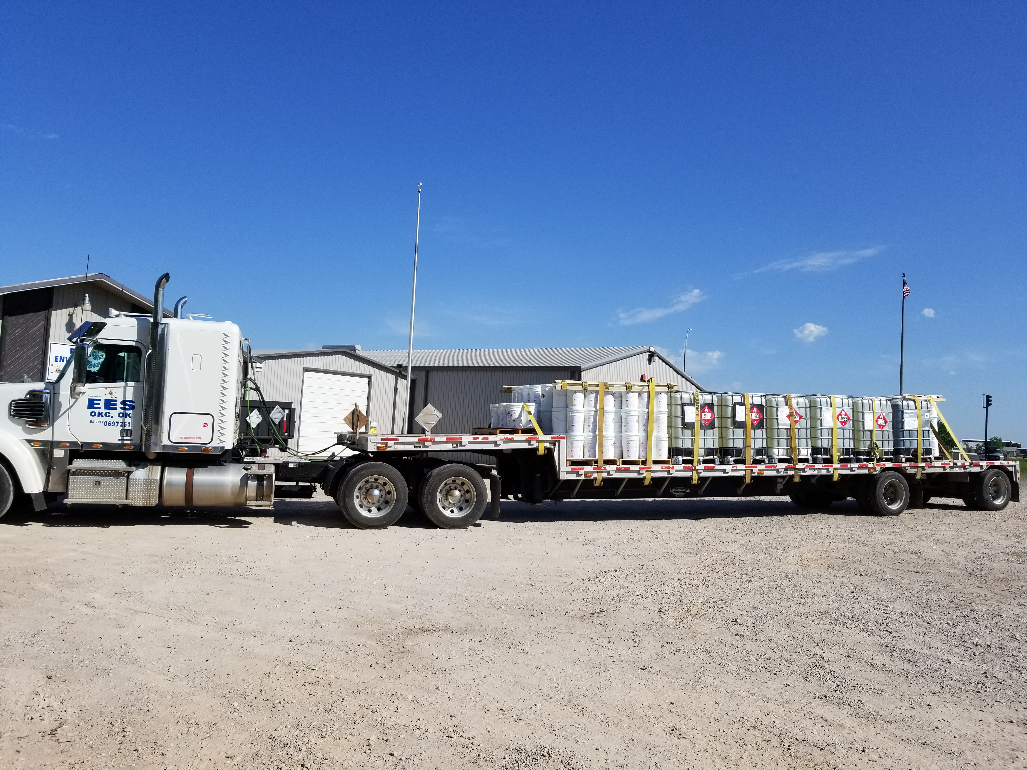
CHEMICAL MANUFACTURING SEGMENT
Enduro-Tech Oilfield products
Liquid products
Solid products
Encapsulated products
Pellets
Water treating products
Toll Blending operation: EPA certified facility

Slide 10
EES 2023 CHEMICAL MANUFACTURING SEGMENT STRATEGY
Develop
NEW Solid chemicals for the oil and gas industry
Identify
New liquid products for solid applications
Increase
Manufacturing capacity of our solid chemical products

Slide 11
Oilfield Chemicals & Services Segment
Locations
Chemical Sales:
Ratliff City, OK,
Ada, OK,
Cleveland, OK,
Abilene, TX,
Canadian, TX
Lab Services:
Ratliff City, OK,
Chickasha, OK,
Cleveland, OK,
Distribution/Warehousing:
Ratliff City, OK,
Cleveland, OK,
Ada, OK,
Abilene, TX,
Canadian, TX

Slide 12
Oilfield Chemicals & Services Segment
Testing & analysis for specific chemical needs
Water analysis, Solid analysis, oil in water analysis
Product delivery & setup
Saltwater disposal facility treatments
Chemical treatments for production & completion
Truck Treating services
Pipelines: oil and gas gathering facilities

Slide 13
EES 2023 OILFIELD SEGMENT STRATEGY
Grow
Strategically grow through acquisitions
Identify
Identify targets in our business segments with total revenue between $2 - $10 million annually.
Increase
Increase market share in North Texas, Texas Panhandle, and Oklahoma

Slide 14
PROTECTIVE COATINGS SEGMENT
Enduro-Bond® is a dry powder coating process that will make ductile iron and carbon steel valves perform like stainless steel.
Protects where others fail. Not a paint; it is more durable than plastics, ceramics and epoxy.
Produces a smooth, even 1-2 mils of protective coating to all areas of metal parts.
Protects threads without compromising the makeup or tolerance of your connections.
Resistant to salt water, H₂S, carbon dioxide, oxygen and CO₂.
High temperature reaction (750-850ºF) allows high temperature stability, eliminates pin-holes in coating and has tensile strength greater than steel.
Reduces operation expenses in production, refining and industrial processing.

Slide 15
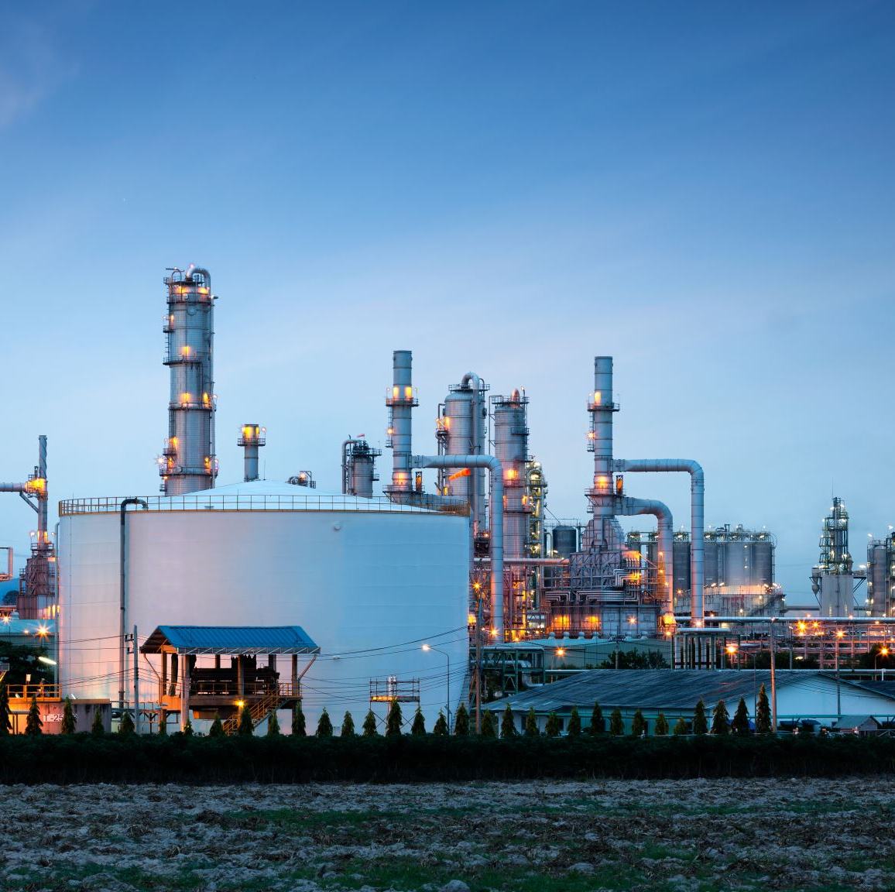
EES 2023 PROTECTIVE COATING STRATEGY
Adding additional sales reps in California
Increasing sales staff with new hire in Louisiana
Focus on gaining customers outside of oil and gas industry
International Coating Representative agreement with AMSAT International, Inc December 2022 to rep Enduro-Bond coating in Korea.

Slide 16
EST AG PRODUCTS Microbe & Enzyme based Farm & Ranch products
WonderScent odor eliminator
Terra Secure liquid organic fertilizer
Pigs in Z Blanket pig farrowing product
BioBlend feed additive probiotic supplement

Slide 17
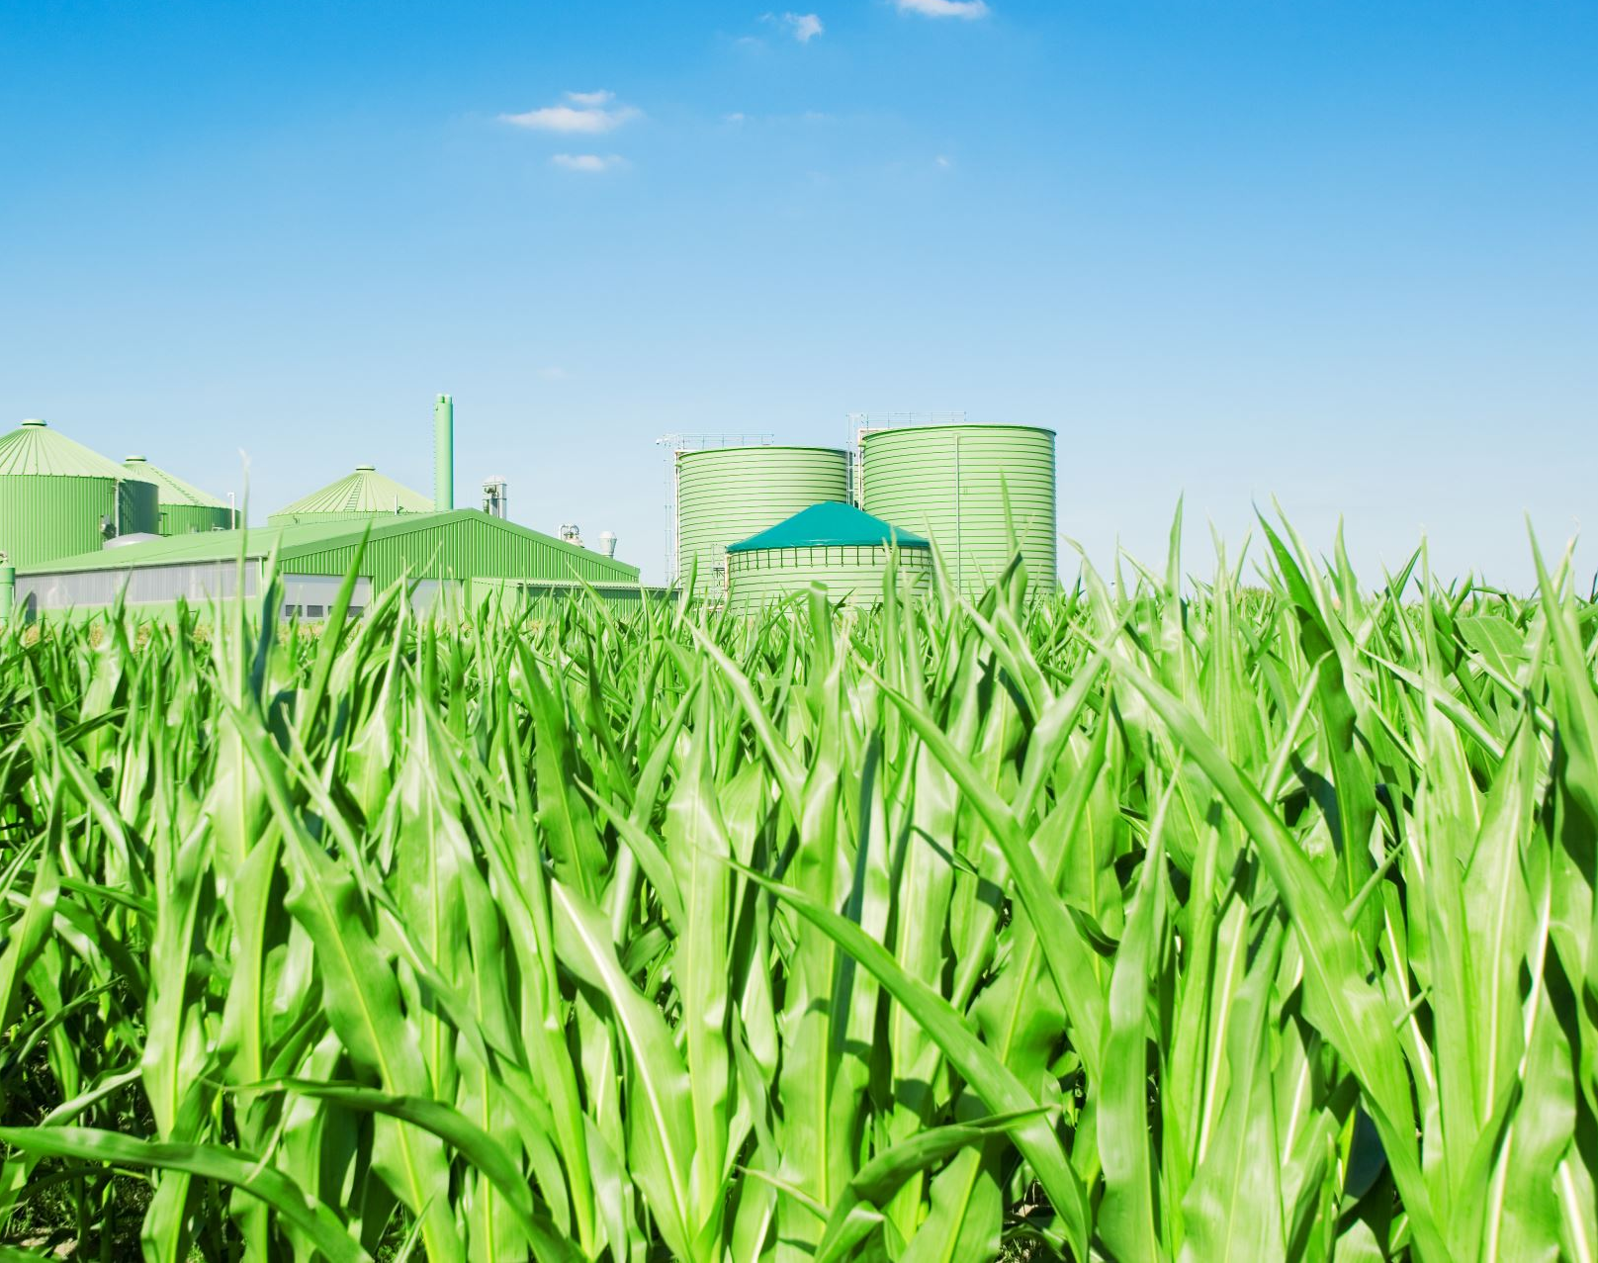
EES 2023 AG SEGMENT STRATEGY (MICROBES/ENZYMES)
Continue to develop revenue outside the oil and gas industry
Manufacture and market Terra Secure liquid fertilizer
Manufacture & market WonderScent (now in 56 stores in Oklahoma)
Distributor for LOCUS Ag products in Oklahoma
Manufacture & market BioBlend animal probiotic supplements

Slide 18
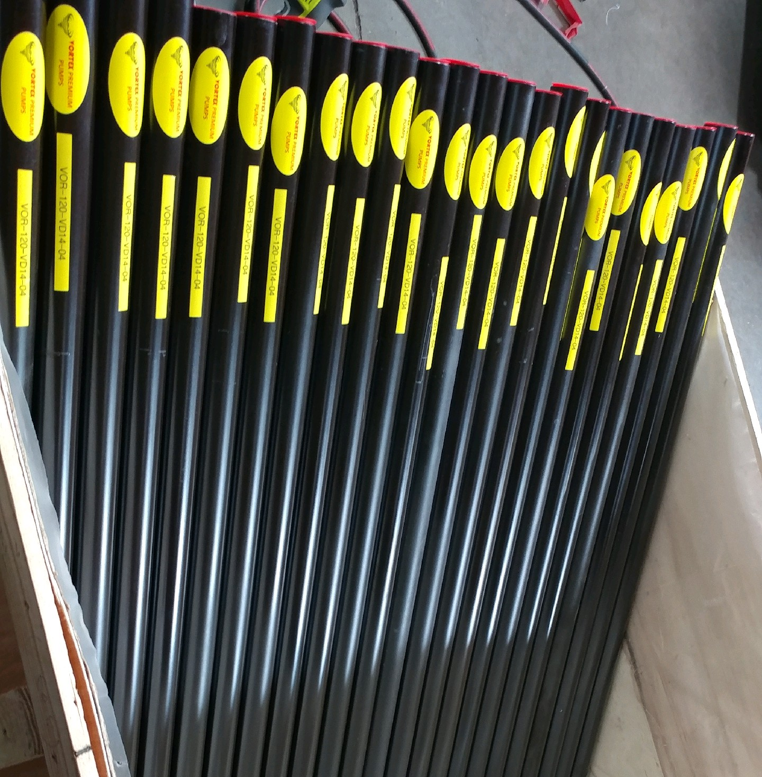
EQUIPMENT MANUFACTURING VORTEX JOINT VENTURE
Vortex Premium coated pump barrel operation
Vortex provides a product that is lower cost and provides superior service to the oil and gas producer.

Slide 19
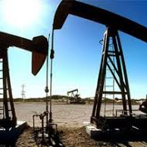
Vortex Premium coated pump barrel operation We start with Precision steel pump barrels and coat them with Enduro-Bond protective coating inside and out. The Vortex pump barrels perform equivalent to brass Chrome or brass Ni-Carb coated pump barrels. The Vortex pump barrel sales for ½ the price of a brass chrome or Ni-carb coated barrel. Vortex provides a product that is lower cost and provides superior service to the oil and gas producer.
2021 revenue from Vortex $22,300
2022 revenue from Vortex $64,700

Slide 20
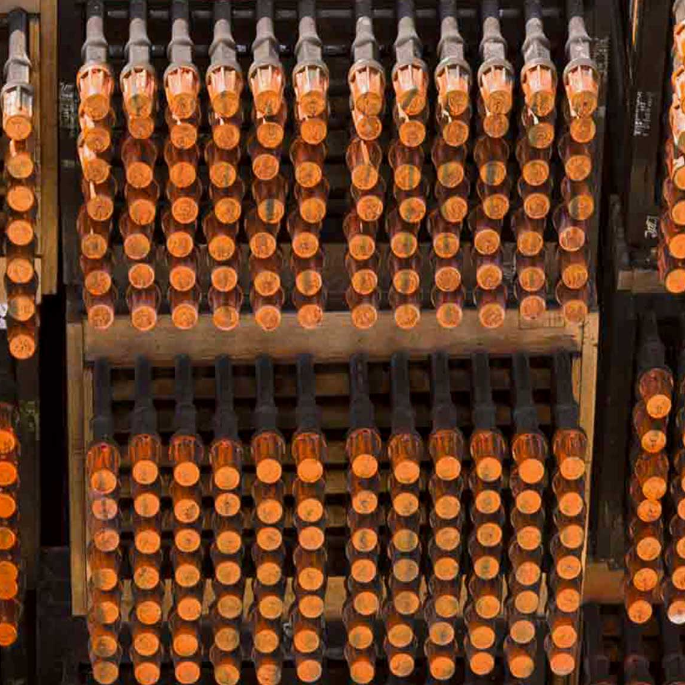
VORTEX PREMIUM COATED PUMP BARRELS CHANNEL TO THE MARKET
Vortex uses manufacturer representatives to sell to the oil and gas industry.
OPECO has 16 sales reps in 8 states; Oklahoma, Texas, Kansas, Nebraska, Alabama, Arkansas, Louisiana, and Mississippi.
Energy Sales has 10 sales reps in 2 states; New Mexico, and Texas.

Slide 21
EES VISION STATEMENT
We are driven to provide the best service in the industry while providing high quality products at a great value.

Slide 22
CONCLUSION
Proactively searching for acquisitions
Focusing on increasing market share in new industries outside of oil and gas
Professional Board of Directors and independent counsel guiding the company toward long-term success.
Experienced management team
Over 200 years of combined experience in manufacturing, oilfield chemicals & services, and protective coatings.
For more investor information contact Leon Joyce
Office: 800-635-7716 Email: ljoyce@eesokc.com

